Slide 1
Privacy-Preserving Dynamic Learning of Tor Network Traffic Rob Jansen, Matthew Traudt, Nicholas Hopper
In 2018 ACM SIGSAC Conference on Computer and Communications Security (CCS ’18).
Presenter: Akhil Thomas

Slide 2

Primary Goal
To better understand Tor traffic and
its characteristics so that we can more accurately generate traffic in
private Tor networks and simulators

Slide 3
Agenda
Measuring Tor
Learning Tor Traffic
Building Traffic Models
Evaluating Traffic Models

Slide 4
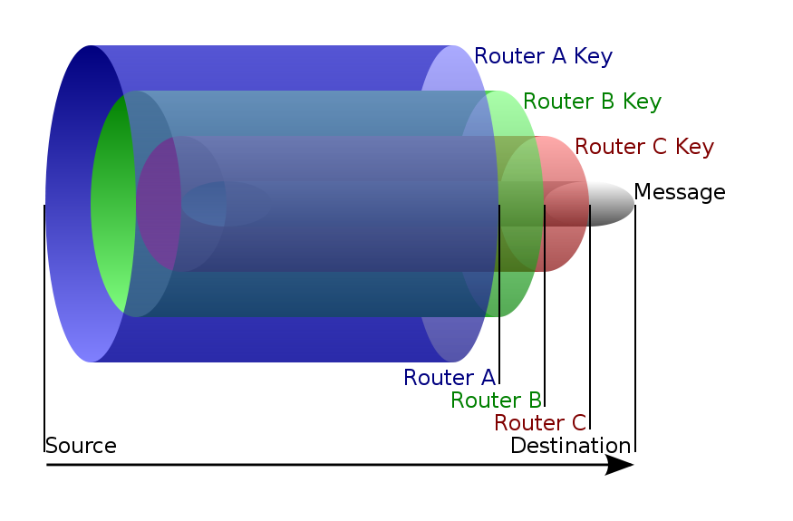
TOR (The Onion Router)
Multiple set of encryption can be done on each path to increase security, nested like an onion.
Each relay has only data of previous one, no relays know the complete path
Distribute your transactions over several places on the Internet, so no single point can link to your destination

Slide 5
1. Measuring Tor
Measurement tool: PrivCount (Privacy preserving counting)
Achieves forward privacy during measurement.
The adversary cannot learn the state of the measurement before time of compromise.
Provides differential privacy of the results.
Prevent confirmation of the actions of a specific user given the output.

Slide 6
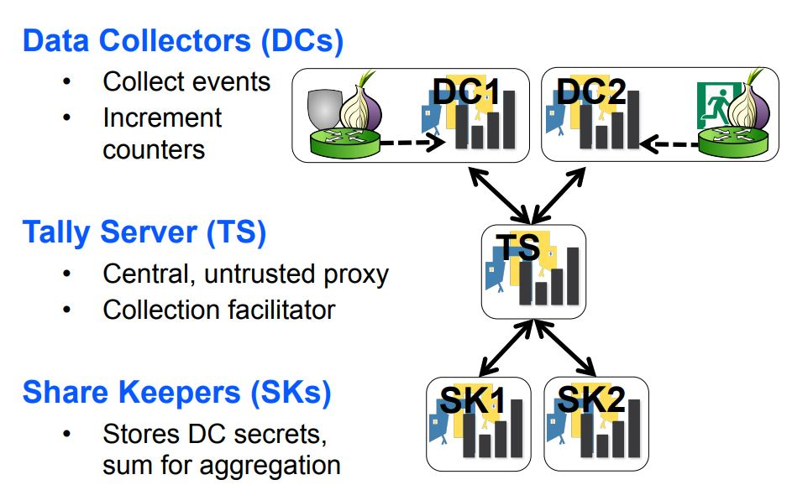
1. Measuring Tor
DC: worker
TS: commander
SK: storage manager
PrivCount Architecture

Slide 7
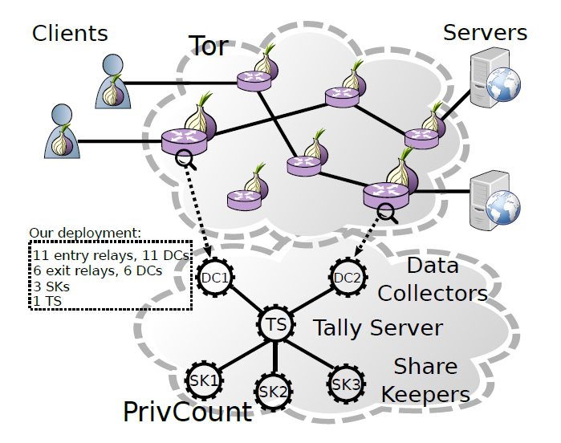
1. Measuring Tor
Architecture
11 Entry relays (Tor)
11 Data Collectors (DC)
6 Exit relays (Tor)
6 Data Collector (DC)
3 Secret Keepers (SK)
1 Tally server. (TS)
The PrivCount nodes and the Tor relays were run by 3 different operators in 3 different countries: Canada, France, and the United States

Slide 8
1. Measuring Tor
Analysis of Tor traffic including:
The number of active and inactive clients.
The number of active and inactive circuits and their distribution per client.
The number and types of streams and their distribution per circuit.
The number of inbound and outbound bytes and their distribution per stream.

Slide 9
1. Measuring Tor
Two phases:
General Measurement phase (overall information of Tor):
Total number of clients, circuits, streams, and bytes and their breakdown into traffic classes.
The distribution of these data.
Traffic model measurement phase:
To measure Hidden Markov Models for stream and packet

Slide 10
Measuring Traffic Statistics (mean number calculated in every 10 minutes)
1. Measuring Tor
Entry Statistics (can only observe clients and circuits while not the stream)
For 14,010 unique clients: 71.2% is active and 24.2% inactive
(The large number of inactive clients may be due to users who have Tor browser open but are not using it. )
For 679,300 circuits: 42.4% active and 57.6% inactive
(The large number of inactive circuits are caused by Tor clients preemptively building circuits (part of Tor’s design) that are never used.)

Slide 11
Measuring Traffic Statistics (calculate the mean number in 10 minutes)
1. Measuring Tor
Exit Statistics (Unable to observe clients but can observe streams.)
a. Traffic totals:
52.8% of circuits are active and 46.1% are inactive.
88.6 % of the active circuits carry web traffic, 2.68 % of the active circuits carry file sharing traffic and 15% carry other kinds of traffic.
large majority of circuits (88.6 percent), streams (90.4 percent), and bytes (72.5 percent) are associated with web ports 80 and 443, while most of the remaining traffic is associated with other ports.

Slide 12
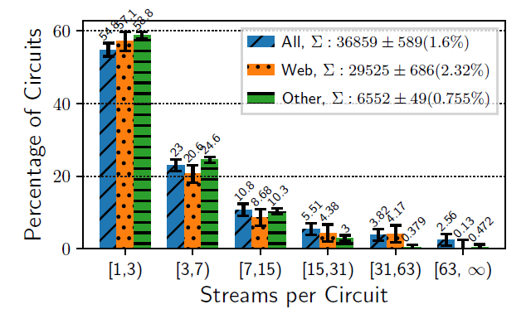
1. Measuring Tor
Exit Statistics (Unable to observe clients but can observe streams.)
b. Traffic Distributions
55%~59% of active circuits carry only 1 or 2 streams
21%~25% of circuits carry 3 to 6 streams

Slide 13
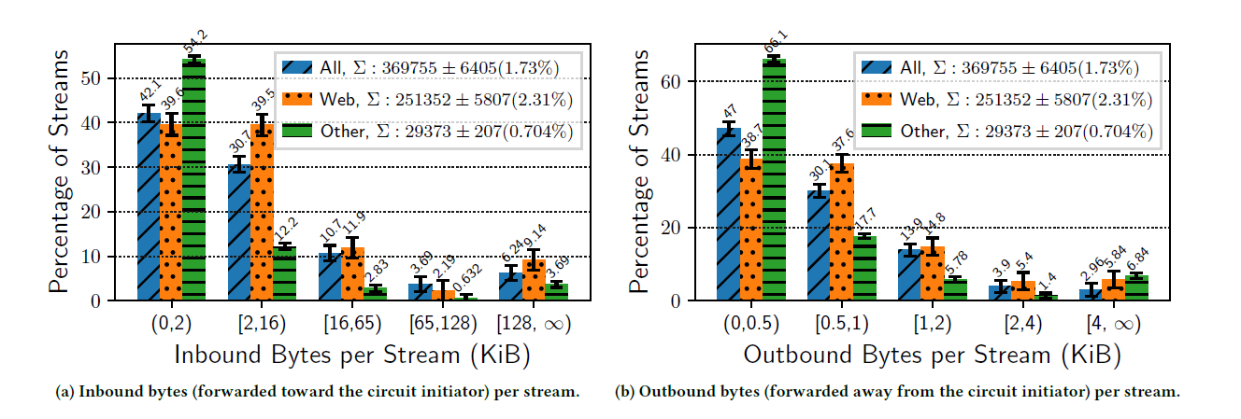
1. Measuring Tor
b. Traffic Distributions
70 to 80 percent of streams receive less than 16 KiB inbound, while about 75 to 85 percent of streams send less than 1 KiB outbound

Slide 14
2. Learning Tor Traffic
Method:
Using hidden Markov models (HMM) and an iterative PrivCount measurement process to model both the creation of streams and the traffic on a stream (i.e., packets)

Slide 15
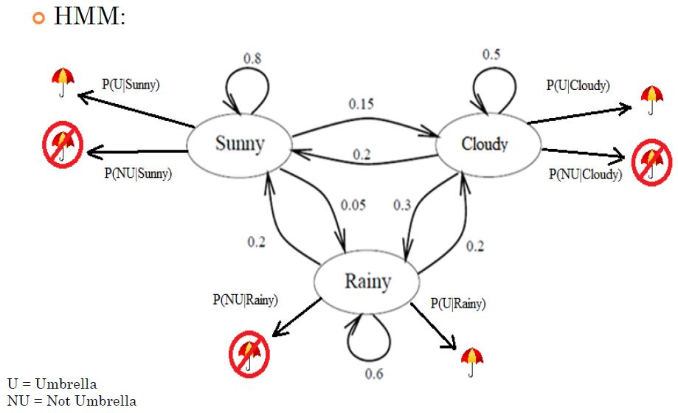
Hidden Markov Model
2. Learning Tor Traffic
In HMM, states of the model are hidden. Each state can emit an output which is observed.
Imagine: You were locked in a room for several days and you were asked about the weather outside. The only piece of evidence you have is whether the person who comes into the room bringing your daily meal is carrying an umbrella or not.
What is hidden? Sunny, Rainy, Cloudy
What can you observe? Umbrella or Not

Slide 16
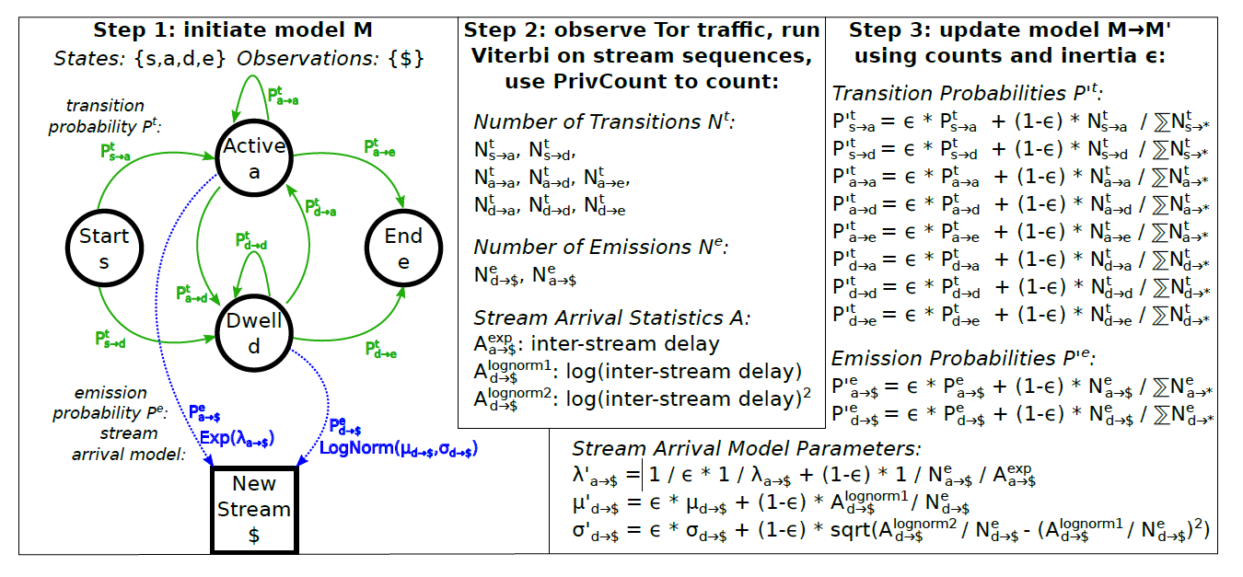
Step 1: Initiate relays with the current HMM parameters
Step 2: Update sums for the number of observations of each state, the number of transitions between each pair of states, and summary statistics for the observations for each state.
Step 3: The aggregated counters were used to compute new parameters for the HMM

Slide 17
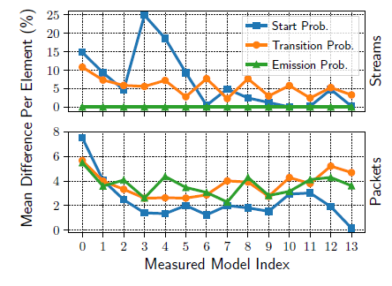
2. Learning Tor Traffic
Results:
(A series of 14 iterations. Each iteration involved a 24-hour measurement period. “inertia” value equals to 0.5, meaning that it gives both parameter sets equal weight)
a. Parameter Convergence
The change in parameters in the final model are significantly lower than the changes in the first model, and that the differences generally decreased over measurement iterations

Slide 18
2. Learning Tor Traffic
b. Model Improvement
How?
Step1: The Relay computes the most likely sequence of states under each model M(i) and the log likelihood of the observed sequence, ℓ(i).
Step2: The relay compares each pair ℓ(i), ℓ(j) to determine which model gave the sequence a higher likelihood, and added this result to a counter.
Step3: After 24 hours, these pairwise counters were taken as the output of the experiment.
Intuitively, A better model for a process should assign higher likelihood to the output of the process more often

Slide 19
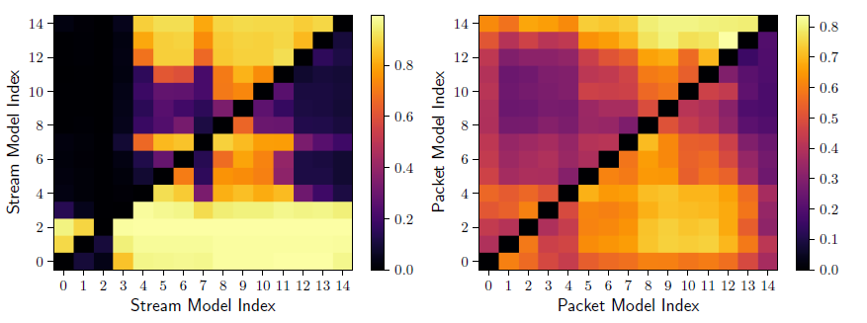
2. Learning Tor Traffic
b. Model Improvement
Fraction of observed sequences more likely under model x than model y
The stream and packet models at index 9 has the best performance
The later models are generally superior fits to new data than the earliest models

Slide 20
3. Building Traffic Models
Using a traffic generation tool called TGen that can be used to create arbitrarily complex patterns of behavior.
Three client models:
Single File Models:
(1)“web” client type that downloads 320 KiB files and pauses in between repeated downloads (to mimic user “think time”),
(2) “bulk” client type that repeatedly downloads 5 MiB files without pausing;
Protocols Models: HTTP (Alexa top 1 million sites list) and BitTorrent;
PrivCount Model: Use the Tor measurement results of this paper and HMM stream and packet models as the basis for traffic generation.

Slide 21
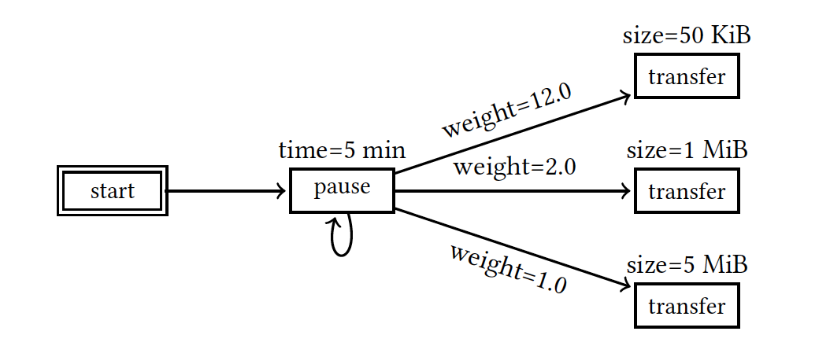
3. Building Traffic Models
A client downloads one of three differently-sized files (50 KiB, 1 MiB, and 5 MiB) every five minutes from a server, where each transfer has a weighted chance of being chosen after each five minute pause completes
Architecture of TGen

Slide 22
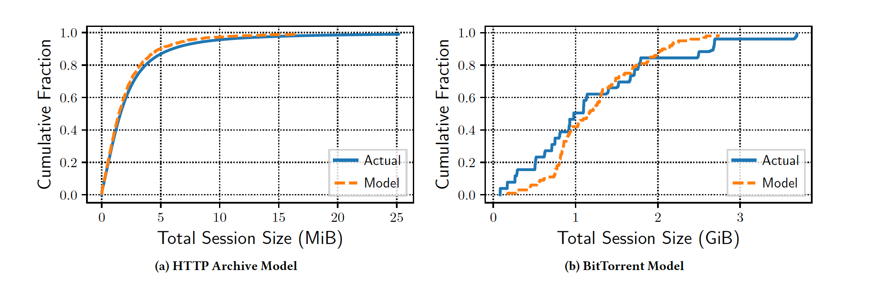
3. Building Traffic Models
Total session size distribution in their general user models compared to actual session sizes in the full datasets.
The model approximates the dataset reasonably well

Slide 23
4. Evaluating traffic models
Use Shadow to evaluate and compare the traffic models.
(Shadow is a network simulator that runs real applications, including Tor and Tgen)
For Single File Model: 2000 Tor relays, 5000 TGen servers, and 60,000 TGen clients;
For Protocol Model: 11,943 clients and half of them are “bulk” clients;
For PrivCount Model: 128,519 TGen clients.

Slide 24
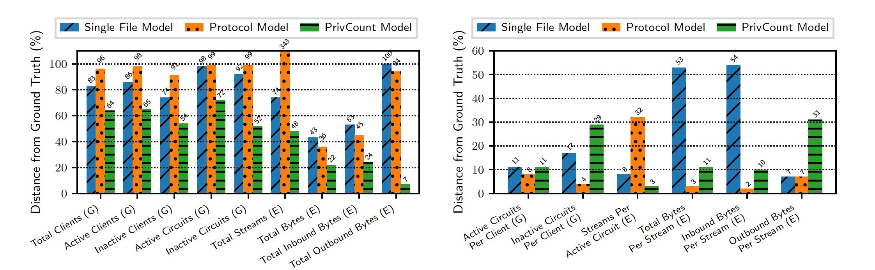
4. Evaluating traffic models
Compare the measurement results from each Shadow experiment to the ground truth Tor measurements using
earth mover’s distance as a metric.
The cumulative percentage distance across all nine single counters was 703% for the single file model, 1001% for the protocol model, and 408% for the PrivCount model.
The cumulative percentage distance across all six histogram counters was 150% for the single file model, 56% for the protocol model, and 95% for the PrivCount model.

Slide 25
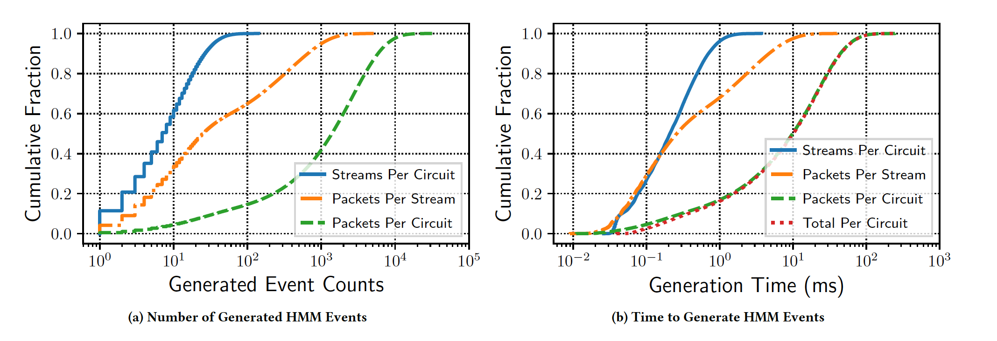
4. Evaluating traffic models
Performance overhead of our HMM generator processes
Fewer than 165 streams per circuit, 7,211 packets (∼10.5 MiB) for a single stream, and did not generate more than 35,568 packets (51.9 MiB) for all streams in a circuit
The maximum total generator time for all streams and packets in a circuit was 278 milliseconds

Slide 26
Thanks!
Q&A

